Slide 1

Azure OpenAI Service
Hicham Zmarrou
Cloud architect

Slide 2
Plan for today
Time | Topic
09:30 – 10:00 | Introduction and setting expectation
10:00 – 11:00 | Emerging architectures for GenAI applications and the corresponding organization
11:00 – 11:15 | Break
11:15 – 12:15 | Use case ideation and brainstorming
12:15 – 13: 15 | Lunch Break
13:15 – 14:00 | Intro to Azure OpenAI, Prompt Engineering & Demos
14:00 – 15:00 | Lab #1 - Hands-on with Prompt Engineering Exercises
15:00 – 16:00 | Intro to AI Orchestration
15:00 – 17:00 | LangChain fundamentals and use cases
Notes:
Narrative/talk track:
The MSFT / OpenAI partnership and how we collaborate
Microsoft has formed a partnership with OpenAI to collaborate on the development of artificial intelligence technologies. The partnership aims to accelerate the development of advanced AI systems and bring the benefits of AI to more people.
As part of the partnership, Microsoft and OpenAI have agreed to work together on several key areas, including:
Developing AI technologies: The two companies will collaborate on the development of new AI models and algorithms, with a focus on natural language processing, computer vision, and other areas of AI.
Building an AI computing platform: Microsoft and OpenAI will work together to build a new AI computing platform that will allow developers to easily access and use advanced AI models and algorithms.
Advancing AI research: The two companies will also collaborate on a range of research projects aimed at advancing the state of the art in AI.
Making AI more accessible: The partnership aims to make AI more accessible to a wider range of developers and organizations, in order to bring the benefits of AI to more people.
Microsoft has also announced it will use OpenAI's GPT-3 technology to add more capabilities to its products such as Cortana, Power Virtual Agents and Dynamics 365.
Additionally Microsoft has also made an investment in OpenAI, allowing the company to use Microsoft Azure as its preferred cloud platform, and allowing OpenAI to tap into the vast resources of Microsoft to accelerate its research. This partnership gives OpenAI the ability to scale its models and services on Azure and make them more widely available to customers.
Overall, the partnership between Microsoft and OpenAI aims to accelerate the development and use of advanced AI technologies, with a focus on making AI more accessible to developers and organizations, in order to bring the benefits of AI to more people.

Slide 3
Plan for day 02 and day 03
Day 2:
Load and Enrich Multiple File Types with Azure Cognitive Search
Load CSVs (One-to-Many) to Azure Cognitive Search
Handling Complex/Large Documents
Building a Retrieval Augmented Generation System (Advanced RAG)
Day 3:
Understanding Memory in LLMs
Q&A against Tabular Data from a CSV File (Experimental)
Q&A against a SQL Database (Azure SQL, Azure Fabric, Synapse, SQL Managed Instance, etc.)
Smart Agents
Notes:
Narrative/talk track:
The MSFT / OpenAI partnership and how we collaborate
Microsoft has formed a partnership with OpenAI to collaborate on the development of artificial intelligence technologies. The partnership aims to accelerate the development of advanced AI systems and bring the benefits of AI to more people.
As part of the partnership, Microsoft and OpenAI have agreed to work together on several key areas, including:
Developing AI technologies: The two companies will collaborate on the development of new AI models and algorithms, with a focus on natural language processing, computer vision, and other areas of AI.
Building an AI computing platform: Microsoft and OpenAI will work together to build a new AI computing platform that will allow developers to easily access and use advanced AI models and algorithms.
Advancing AI research: The two companies will also collaborate on a range of research projects aimed at advancing the state of the art in AI.
Making AI more accessible: The partnership aims to make AI more accessible to a wider range of developers and organizations, in order to bring the benefits of AI to more people.
Microsoft has also announced it will use OpenAI's GPT-3 technology to add more capabilities to its products such as Cortana, Power Virtual Agents and Dynamics 365.
Additionally Microsoft has also made an investment in OpenAI, allowing the company to use Microsoft Azure as its preferred cloud platform, and allowing OpenAI to tap into the vast resources of Microsoft to accelerate its research. This partnership gives OpenAI the ability to scale its models and services on Azure and make them more widely available to customers.
Overall, the partnership between Microsoft and OpenAI aims to accelerate the development and use of advanced AI technologies, with a focus on making AI more accessible to developers and organizations, in order to bring the benefits of AI to more people.

Slide 4
Generative AI
Artificial Intelligence
1956
Artificial Intelligence
the field of computer science that seeks to create intelligent machines that can replicate or exceed human intelligence
Machine Learning
1997
Machine Learning
subset of AI that enables machines to learn from existing data and improve upon that data to make decisions or predictions
Deep Learning
2017
Deep Learning
a machine learning technique in which layers of neural networks are used to process data and make decisions
2021
Generative AI
Create new written, visual, and auditory content given prompts or existing data.
Notes:
Narrative/talk track:
What is a brief history of artificial intelligence?
Artificial intelligence (AI) has a long and storied history that spans many decades. Some of the earliest work in AI was done in the 1950s and 1960s, when researchers first began to explore the possibility of creating machines that could "think" like humans.
During the 1950s and 1960s, AI research focused primarily on "symbolic" AI, which involved creating symbolic representations of knowledge and using them to solve problems. Researchers in this field developed early versions of what are now known as expert systems, which are computer programs that mimic the decision-making abilities of human experts in a specific domain.
In the 1970s and 1980s, AI research began to shift away from symbolic AI and towards "sub-symbolic" AI, which involves using statistical methods and mathematical models to solve problems. This shift was driven in part by the realization that symbolic AI was too complex and difficult to scale, and in part by the development of new computer hardware that made it possible to process large amounts of data quickly.
In the 1990s and 2000s, AI research continued to evolve, and new subfields began to emerge. One of these was "machine learning," which focuses on creating algorithms that allow computers to learn from data without being explicitly programmed. Another was "neural networks," which are mathematical models inspired by the structure and function of the human brain.
Recently, Generative Models like GPT-3 and DALL-E, Variational Autoencoders, Generative Adversarial Networks and many more have risen and continue to advance the field of AI. These models are able to generate new examples that are similar to examples from a given dataset. It is being used in diverse fields such as natural language processing, computer vision, speech recognition and many more.
Overall, AI has come a long way since its inception in the 1950s, and it continues to evolve and improve at a rapid pace today.
What is Generative AI and where does it fit into the scope of AI?
Generative AI is a subfield of Artificial Intelligence that focuses on creating systems that can generate new examples, such as images, text, or speech, that are similar to examples from a given dataset. The goal of generative AI is to develop algorithms that can learn the underlying probability distribution of a given dataset and use this knowledge to generate new examples that are similar to the examples in the dataset.
Generative AI models can be classified into two broad categories: generative models and discriminative models. Generative models such as GPT-3, DALL-E, Variational Autoencoders etc learns the underlying probability distribution of the dataset and can generate new examples from the learned distribution. Discriminative models, such as deep neural networks, learn to differentiate between different classes or categories, and are generally used for tasks such as image or speech recognition.
Generative AI sits on top of other areas of AI like unsupervised learning, supervised learning and reinforcement learning. It relies on the capability of those models to extract useful features from the data and use that for learning the underlying probability distribution of the data which is used for generthe potential to be used in a wide range of applications, such as computer vision, natural language processing, speech recognition, and many more.
ating new examples.
Overall, generative AI is a rapidly growing field within AI, and it has

Slide 5
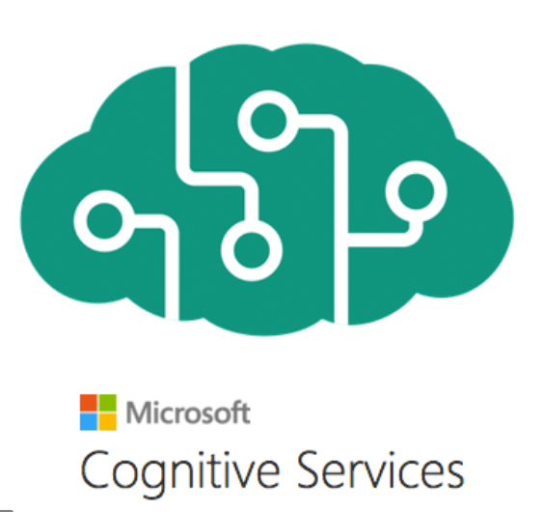











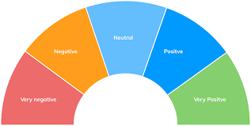

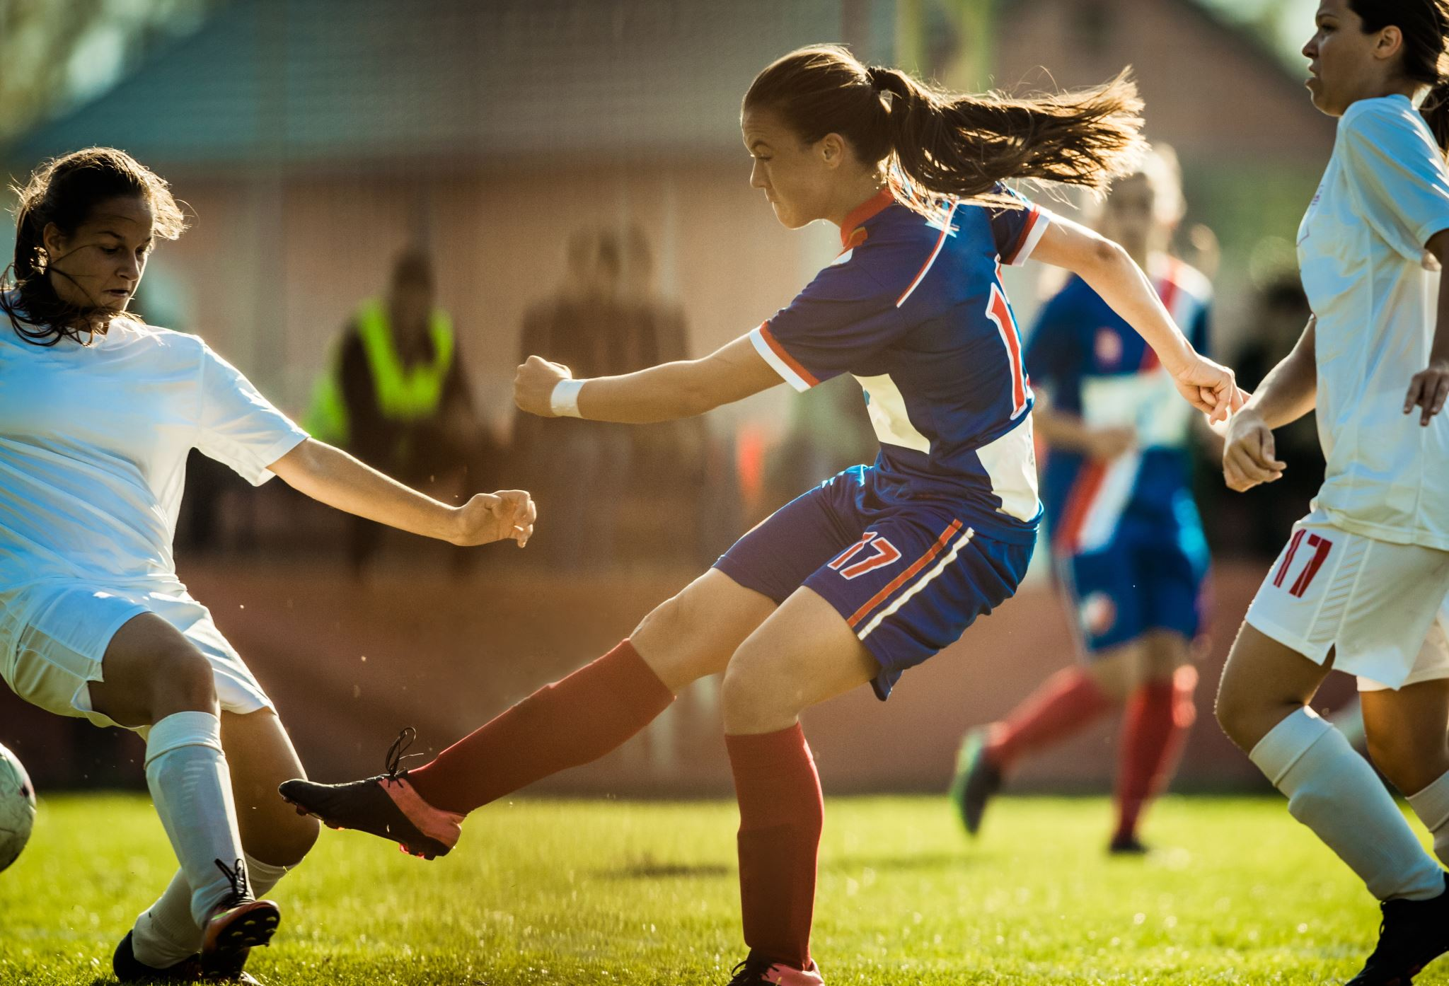
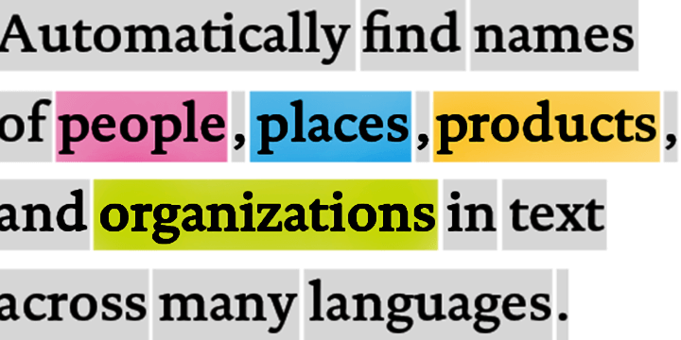
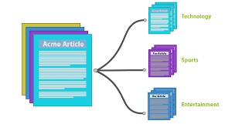








Traditional model development High cost and slow deployment—each service is trained disjointly
DEPLOYMENTS
Tagging Services
Spatial Analysis Services
Accessibility Services
Spatial Presenter
Azure Search, Video Indexer
EAGLE
EAGLE
FLOWER
PLAYING SOCCER
Classification
Object Detection
Object Tracking
Action Recognition
Entities
Topics
Sentiments
TASKS
Classification Model
Detection Model
Tracking Model
Action Model
Entity Recognition
Topic Classification
Sentiment Analysis
INDIVIDUAL MODEL (DISJOINTLY)
TRAINING DATA
(w/ ANNOTATION)
Tagging data
Detection data
Tracking data
Action data
Entity data
Topic data
Sentiment data
Notes:
(This and the next 9 slides help with the flow to move from the high-level to the deep dive)
The traditional approach of AI model development involves training a model on a very specific dataset with a specific task in-mind. For example, an entity recognition model requires specifically tagged entity data and a sentiment analysis model requires specifically trained sentiment data, which can be a bottleneck in training ML models. As a result, not only is a lot of tagged data required, but the data remains segmented for specific tasks, leading to higher development costs and slower deployments.

Slide 6

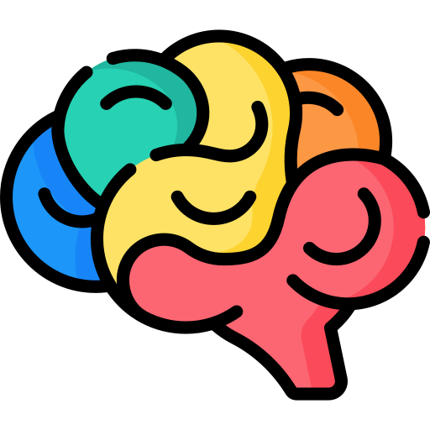



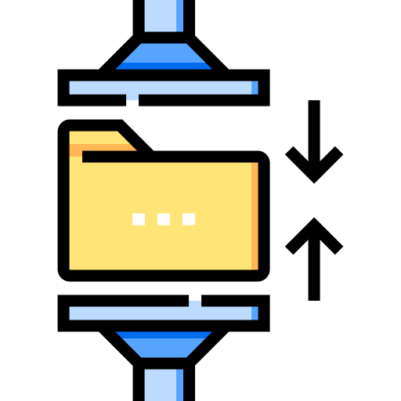

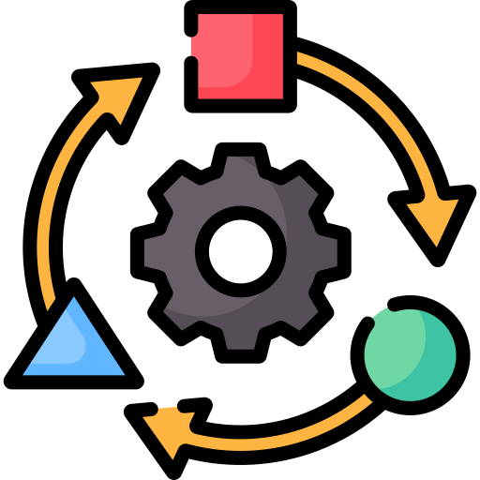

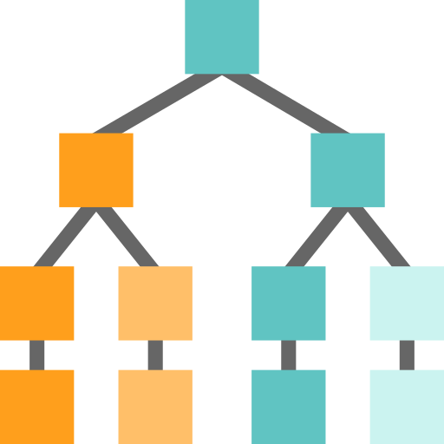



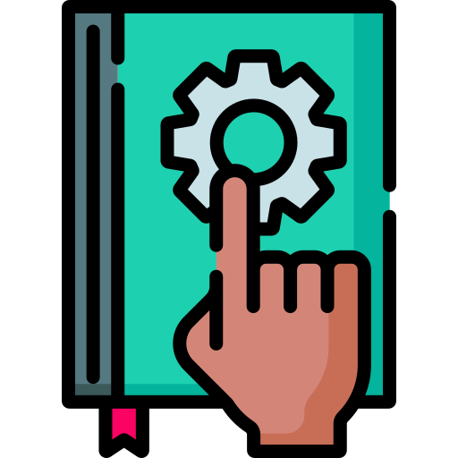
Foundation Models
Tasks
Question and Answering
Data
Sentiment Analysis
Text
Foundation Model
Information Extraction
Images
Speech
Training
Adaptation
Image Captioning
Structured Data
3d Signals
Transformer Model
Object Recognition
Instruction Follow
Notes:
The future of AI is models that are flexible, reusable and that can be applied to just about any domain or industry task.
Foundation models are at the heart of many of the latest breakthroughs. These models have been influential in the development of artificial intelligence systems, and have played a major role in changing how AI systems are constructed since their introduction in 2018.
A foundation model is a machine learning model that is trained on a large amount of unlabeled data, allowing it to be adapted to a wide variety of tasks. These models capture general patterns and structure of data, and aim to replace task-specific models by unifying different tasks and modalities into one, eliminating the need to train individual models and integrate several models together. An example is a large language foundation model that can perform various NLP tasks and can be used out-of-the-box due to its extensive training.
Foundation models use self-supervised learning and transfer learning to apply information learned in one situation to another situation or task.
Training these models can be complex and resource-intensive as they are typically large and require a significant amount of data. The scale of these models also plays a big role in the training process. So lets talk about that.

Slide 7


Our partnership with OpenAI
Ensure that artificial general intelligence (AGI) benefits humanity.
Empower every person and organization on the planet to achieve more
GPT-3/4
Codex
DALL·E
ChatGPT
Whisper
Generate and Understand Text
Generate and
Understand Code
Generate images
from text prompts
Generate conversational responses
Convert Speech to Text
Notes:
Narrative/talk track:
The MSFT / OpenAI partnership and how we collaborate
Microsoft has formed a partnership with OpenAI to collaborate on the development of artificial intelligence technologies. The partnership aims to accelerate the development of advanced AI systems and bring the benefits of AI to more people.
As part of the partnership, Microsoft and OpenAI have agreed to work together on several key areas, including:
Developing AI technologies: The two companies will collaborate on the development of new AI models and algorithms, with a focus on natural language processing, computer vision, and other areas of AI.
Building an AI computing platform: Microsoft and OpenAI will work together to build a new AI computing platform that will allow developers to easily access and use advanced AI models and algorithms.
Advancing AI research: The two companies will also collaborate on a range of research projects aimed at advancing the state of the art in AI.
Making AI more accessible: The partnership aims to make AI more accessible to a wider range of developers and organizations, in order to bring the benefits of AI to more people.
Microsoft has also announced it will use OpenAI's GPT-3 technology to add more capabilities to its products such as Cortana, Power Virtual Agents and Dynamics 365.
Additionally Microsoft has also made an investment in OpenAI, allowing the company to use Microsoft Azure as its preferred cloud platform, and allowing OpenAI to tap into the vast resources of Microsoft to accelerate its research. This partnership gives OpenAI the ability to scale its models and services on Azure and make them more widely available to customers.
Overall, the partnership between Microsoft and OpenAI aims to accelerate the development and use of advanced AI technologies, with a focus on making AI more accessible to developers and organizations, in order to bring the benefits of AI to more people.

Slide 8



Why is the sky blue?
OpenAI GPT-3 answer:
The sky is blue because the Earth's atmosphere scatters sunlight in all directions and blue light is scattered more than the other colors because it travels as shorter, smaller waves
Notes:
I’m sure many of you have heard of Open AI’s GPT-3 , this model has literally mastered language and can talk about anything.

Slide 9
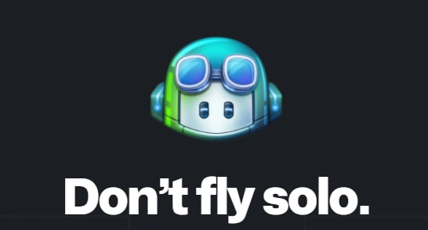
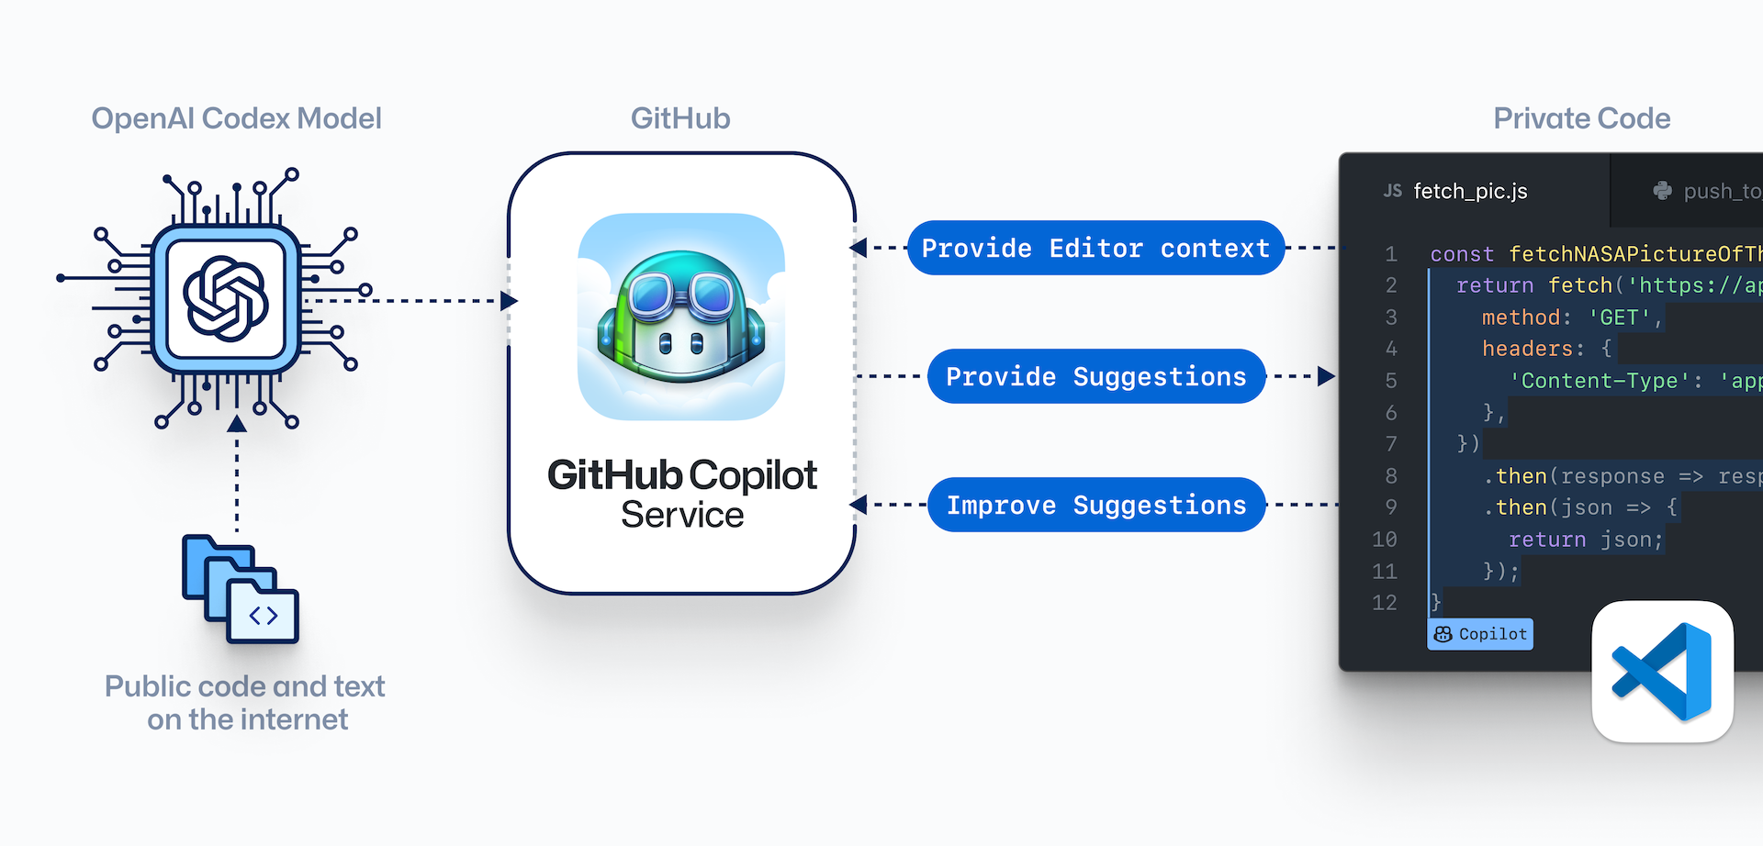

OpenAI + Github
OpenAI Codex Model
GitHub
Private code
Provide editor context
Provide suggestions
Improve suggestions
GitHub Copilot Service
Public code and text on the internet
Notes:
GitHub Copilot, is an AI pair programmer that you can collaborate with and helps to write code and helps you learn new frameworks and best practices.
According to CEO from Github, Copilot is now handling up to 40% of coding among programmers. Put another way, for every 100 lines of code, 40 are being written by the AI,
with a total project time cut by up to 55%. And this is just with the first iteration of the model which has been in production for less than one year.

Slide 10

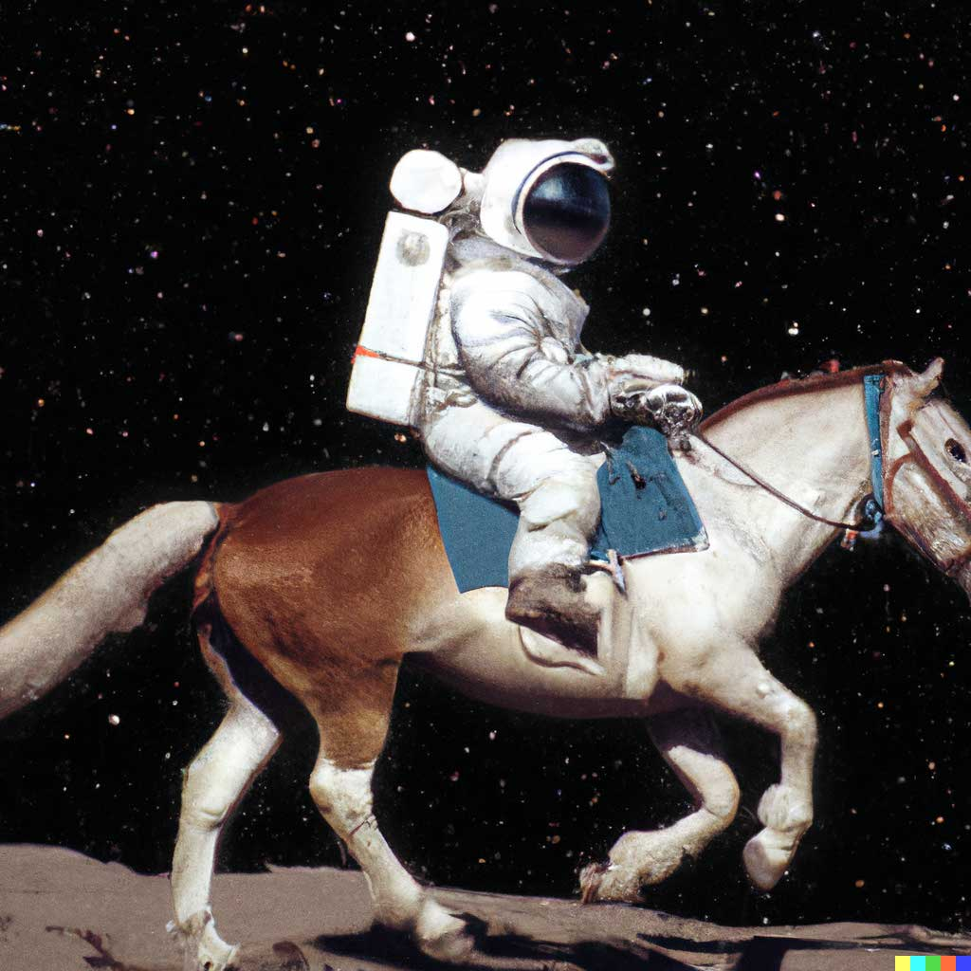


DALL E 2/3
An astronaut riding a horse in a photorealistic style
Teddy bear working on new AI research on the moon in 1980
A bowl of soup that looks like a monster knitted out of wool
Notes:
OpenAI Dalle-2 model can seemingly create spectacular images from just text

Slide 11
Go to Azure AI Studio
Notes:
Narrative/talk track:
The MSFT / OpenAI partnership and how we collaborate
Microsoft has formed a partnership with OpenAI to collaborate on the development of artificial intelligence technologies. The partnership aims to accelerate the development of advanced AI systems and bring the benefits of AI to more people.
As part of the partnership, Microsoft and OpenAI have agreed to work together on several key areas, including:
Developing AI technologies: The two companies will collaborate on the development of new AI models and algorithms, with a focus on natural language processing, computer vision, and other areas of AI.
Building an AI computing platform: Microsoft and OpenAI will work together to build a new AI computing platform that will allow developers to easily access and use advanced AI models and algorithms.
Advancing AI research: The two companies will also collaborate on a range of research projects aimed at advancing the state of the art in AI.
Making AI more accessible: The partnership aims to make AI more accessible to a wider range of developers and organizations, in order to bring the benefits of AI to more people.
Microsoft has also announced it will use OpenAI's GPT-3 technology to add more capabilities to its products such as Cortana, Power Virtual Agents and Dynamics 365.
Additionally Microsoft has also made an investment in OpenAI, allowing the company to use Microsoft Azure as its preferred cloud platform, and allowing OpenAI to tap into the vast resources of Microsoft to accelerate its research. This partnership gives OpenAI the ability to scale its models and services on Azure and make them more widely available to customers.
Overall, the partnership between Microsoft and OpenAI aims to accelerate the development and use of advanced AI technologies, with a focus on making AI more accessible to developers and organizations, in order to bring the benefits of AI to more people.

